Slide 1
WIFI Access
SSID: MSFTGUEST
User: usmsguest
Pass: V322554m
Notes:
MSFTOPEN

Slide 2
TypeScript: Not Your Father’s JavaScript

Slide 3
Introductions
Toi B Wright (toi@onestopdesigns.com)
President , Dallas ASP.Net User Group
Microsoft MVP ASP.NET since 2005
President, Geeks in Pink
Author, 24-Hour Trainer ASP.NET 4
BS in CS from MIT
MBA from CMU

Slide 4
ASP.NET Web Forms and ASP.NET MVC

Slide 5
Welcome
The purpose of this user group is to help developers learn ASP.NET.
Our intent is to provide a forum for you to learn about and discuss the various components of a production quality ASP.NET application.
www.dallasasp.net

Slide 6
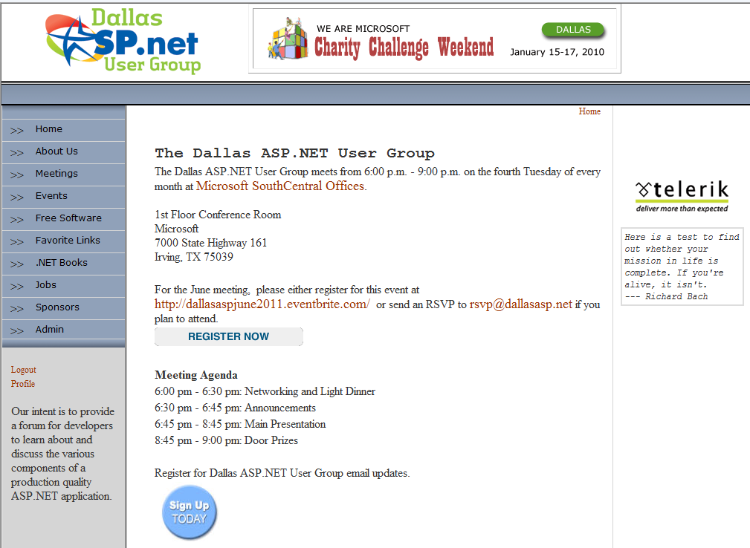
Our Website

Slide 7
Agenda
User Group Business
Announcements
Main Presentation
Door Prizes

Slide 8
User Group Business

Slide 9
Paperwork
Door Prizes
Dues
Renewal / Joiner Gift
RSVP by Noon
T-Shirt Sizes
LinkedIn
Venue Layout
Notes:
LinkedIn

Slide 10
Upcoming Meetings
July 23
HTML5
August 27 – Scott Hanselman
10 Year Anniversary Extravaganza
September 24 – Toi B Wright
ASP.NET Web API
Notes:
The Rich Standard: Getting Familiar with HTML 5

Slide 11
Upcoming Meetings
October 22
IIS
November 26
Tools (Git, NuGet, Powershell, SkyDrive, etc)
December 24
No Meeting
Notes:
The Rich Standard: Getting Familiar with HTML 5

Slide 12

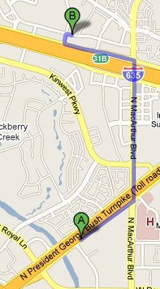
Later Tonight
Chili’s Grill & Bar
1300 Market Place Blvd Irving, TX 75063-7229 214-574-4574
Turn RIGHT onto access road 0.96 mo
Turn LEFT onto N MACARTHUR BLVD. 0.86 mi
Turn LEFT onto access road I-635 W/W LBJ FWY. 0.62 mi
Restaurant is on RIGHT
Notes:
12

Slide 13
Announcements

Slide 14
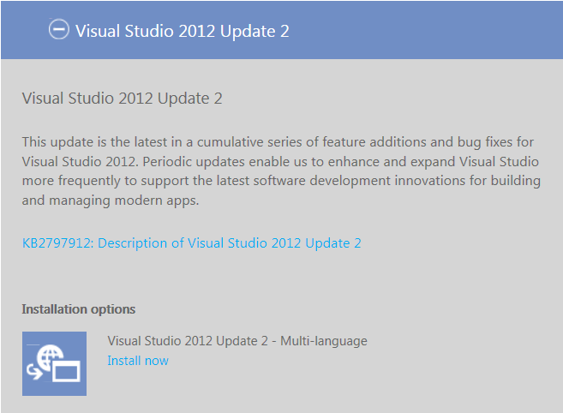
Visual Studio 2012 Update 2 (4/4/2013)
http://www.microsoft.com/visualstudio/eng/downloads

Slide 15

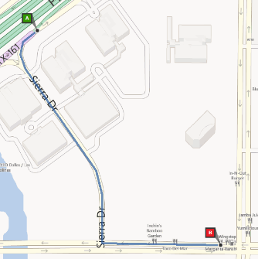
10-Year Extravaganza Party!
Margarita Ranch
Tuesday, August 27
9:30 PM - ??
This restaurant/bar is located right behind
Microsoft's building on
Royal Ln.
http://10YearExtravaganza.eventbrite.com

Slide 16

Book Club Dinner
Lean In: Women, Work, and the Will to Lead by Sheryl Sandberg
Date: Tuesday, September 17
Location: Blue Mesa Grill, Plano
Price: $24
Geeks in Pink is a support group for women in technology. This dinner is an opportunity for girl geeks to get together to discuss their experiences, exchange ideas and network in an informal environment.
http://www.geeksinpink.org

Slide 17
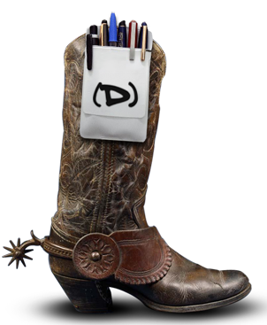
Big D Conference
Date: October 17-20
Location: Crown Plaza, Addison
Price: Varies by Ticket Type
The Big Design Conference is four intense days of learning within the scope of Strategy, Mobile, User Experience, Gaming, Code Development, Usability, and Film Design.
Experts from across the country will gather to present theories, research, experiences, and best practices to students, professionals, and executives looking to stay on the bleeding edge.
http://bigdesignevents.com/conference/

Slide 18

FREE Online Training
Infragistics is offering FREE online training for groups of 10 or more ($4,000 value)
Framework
Silverlight Boot Camp by Infragistics
WPF Boot Camp by Infragistics
Infragistics products
Developing Applications with NetAdvantage® WPF Controls
Developing Applications with NetAdvantage® Silverlight Controls
Contact Aaron Swan for details (aswan@infragistics.com)
www.infragistics.com/services/ui/

Slide 19


Watch User Group presentations
for FREE online!
http://www.UserGroup.tv
We know you cannot make it to every User Group meeting,
that is why we post them online for you!
Miss a User Group meeting?
Forget something that you learned?
Want to see content from a User Group not in your area?
Want to share with a buddy?
Presentations from the thought leaders on the topic.
New Content added all the time!
All the topics you care about
Including:
Agile
C#
Entity Framework
HTML5
MEF
MVC
Silverlight
XAML
jQuery
For new content announcements
@UserGroupTV

Slide 20

WebsiteSpark
The WebsiteSpark program is no longer accepting new membership applications.

Slide 21
Microsoft BizSpark
BizSpark is designed to give startups access to the tools, support and visibility they need, when they need it the most.
Support
Software
Visibility
http://www.microsoft.com/BizSpark
Notes:
Software. Receive fast and easy access to current full-featured Microsoft development tools, platform technologies, and production licenses.
Support. Each of your developers will get access to a MSDN Premium subscription. You'll also get connected a global community of technical and business development experts.
Visibility. Achieve global visibility to an audience of potential investors, clients and partners.
There are no upfront fees for BizSpark access, enrollment or registration services, just a $100 Program Fee upon program exit.

Slide 22
Microsoft BizSpark Requirements
Your Business →
Is in the business of software development
Is privately held
Has been in business for less than 3 years
Has less than US $1 million in annual revenue
Is sponsored by a BizSpark Network Partner
http://www.microsoft.com/BizSpark
Notes:
To enroll, you must be sponsored by a BizSpark Network Partner. Find a BizSpark Network Partner.
To be eligible to use the software for production and deployment of hosted solutions Startups must also be developing a new “software as a service” solution (on any platform) to be delivered over the Internet.

Slide 23
TypeScript: Not Your Father’s JavaScript

Slide 24
Shawn Weisfeld
Shawn is currently a Application Development Manager at Microsoft in Austin, TX. Besides his day job Shawn also is an Adjunct Professor at The Florida Institute of Technology (http://www.fit.edu). He also does freelance software development work for local small businesses and training.
Shawn (http://www.shawnweisfeld.com, shawn@shawnweisfeld.com) is passionate about building awesome line of business applications and websites with .NET technologies. He was previously a Microsoft C# MVP and is the founder of http://UserGroup.tv.

